Slide 1

Disassembly of Bluetooth speaker
MED 210-Principles of Industrial Engineering
Course Instructors:
Divya Shrivastava Ma’am Venkata Krishna Rao Sir

Slide 2
MED 210 Minor Project
PRODUCT DESCRIPTION: Bluetooth trolley speaker
Leela Krishna Pendyala (1910110268)
Praneeth Krishna Palle (1910110282)
Srikara Sriapathi (1910110403)
Notes:
Notes to presenter:
What is your purpose for sharing this reflection?
Is it at the end of a unit or project?
Are you sharing this reflection, at the attainment of a learning goal you set for yourself?
Is it at the end of a course?
State your purpose for the reflection or even the purpose of the learning experience or learning goal. Be clear and be specific in stating your purpose.

Slide 3

Project work Description
Firstly, During the duration of the course we were divide into groups of 3 students, wherein, we were asked to purchase a random toy from market or use any product in home, which is not so small or not so large, and disassemble it.
And then, We were asked to disassemble the product based on various criterion like, standard and non-standard part, and make a list of all assemblies and sub-assemblies present in the product.
Finally,We also have to make a BOM(Bill of material) file and calculate the assembly time required for all BOM parts by using the Boothroyd's Manual Assembly Method.
Notes:
Notes to presenter:
Description of what you learned in your own words on one side.
Include information about the topic
Details about the topic will also be helpful here.
Tell the story of your learning experience. Just like a story there should always be a beginning, middle and an end.
On the other side, you can add a graphic that provides evidence of what you learned.
Feel free to use more than one slide to reflect upon your process. It also helps to add some video of your process.

Slide 4

Bluetooth trolley speaker
The product we have chosen was a Bluetooth trolley speaker. It is a portable wireless Bluetooth trolley party speaker used to produce audio output.
Inserted video in the next slide is a overview of the product.
Notes:
Notes to presenter:
What did you think at first?
What obstacles did you encounter along the way?
How did you overcome those obstacles?
What images can you add to support your process?
This SmartArt allows you add images and text to help outline your process. If a picture is worth a thousand words, then pictures and words should help you communicate this reflection on learning perfectly! You can always click on Insert>SmartArt to change this graphic or select the graphic and click on the Design contextual menu to change the colors.
Feel free to use more than one slide to reflect upon your process. It also helps to add some video of your process.

Slide 5
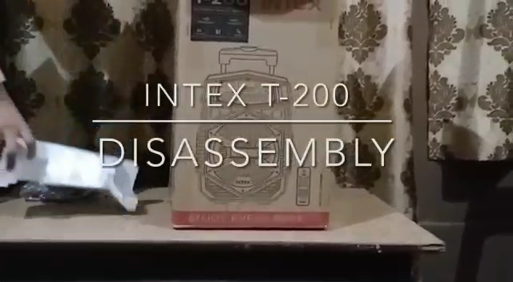
Product Overview video
Notes:
Notes to presenter:
What was important about this learning experience?
How is it relevant to your course, yourself, or your society or community?
Why is this significant?
This SmartArt allows you add images and text to help outline your process. If a picture is worth a thousand words, then pictures and words should help you communicate this reflection on learning perfectly! You can always click on Insert>SmartArt to change this graphic or select the graphic and click on the Design contextual menu to change the colors.

Slide 6
Product components
The Product contained the following main components which are further divided into sub components:
1.Polycarbonate front shield
2.Speaker assembly
3.Primary circuit board(PCB)
4.Secondary circuit board(SCB)
5.Power supply circuit
6.Li-ion 18650 battery
7.Metal strip( for holding battery)
8.LED circuit
9.Speaker back case cover
10.Philips flat head screws
11.Main body assembly
12.Packaging box
Notes:
Notes to presenter:
What steps will you be taking as a result of this learning experience?
Did you learn from any failed experiences? How will you do things differently?
What advice will you give to others so they can learn from your experiences?
How can you share what you learned with a real-world audience?
Some examples of next steps might be:
After delivering my first persuasive presentation, I am thinking about joining the debate team.
After making my first film, I’m considering entering it in our school film festival or local film festival.
After connecting with this career expert, I’d like to do some research on that career field because it sounds interesting to me.
This SmartArt allows you add images and text to help outline your process. If a picture is worth a thousand words, then pictures and words should help you communicate this reflection on learning perfectly! You can always click on Insert>SmartArt to change this graphic or select the graphic and click on the Design contextual menu to change the colors.
Feel free to use more than one slide to share your next steps. It also helps to add some video content to explain your message.

Slide 7
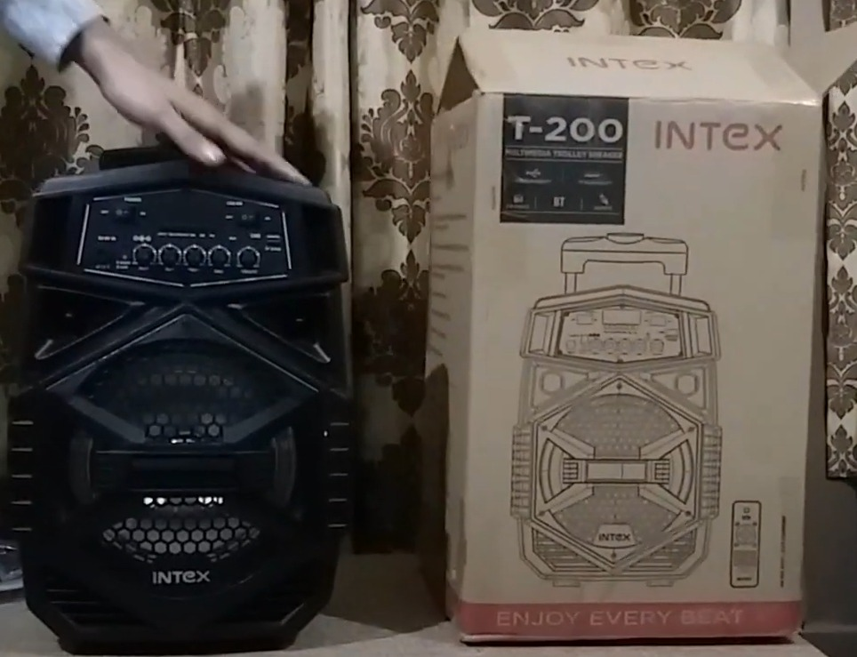
Product overview
Main body assembly
Packaging box
Primary circuit
Board(PCB)
Polycarbonate
Front shield

Slide 8
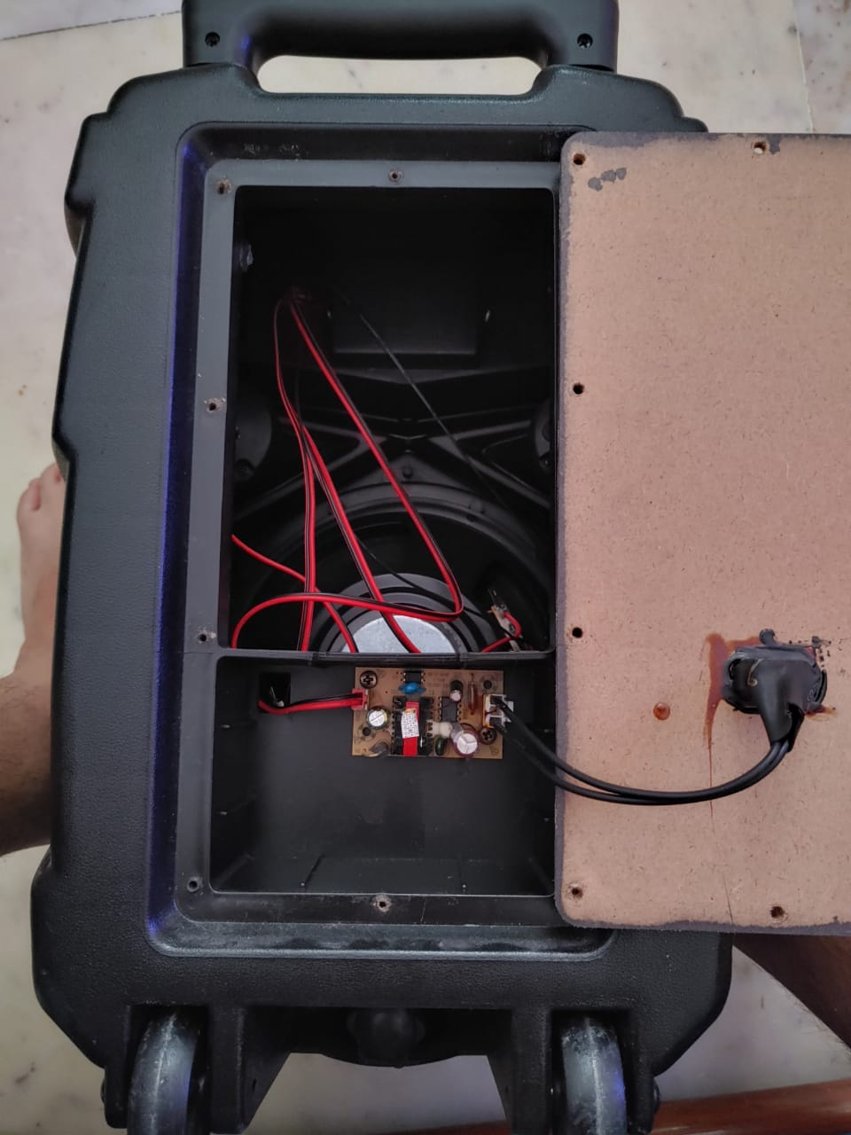
Product overview
Back case cover
Speaker assembly
Power circuit

Slide 9
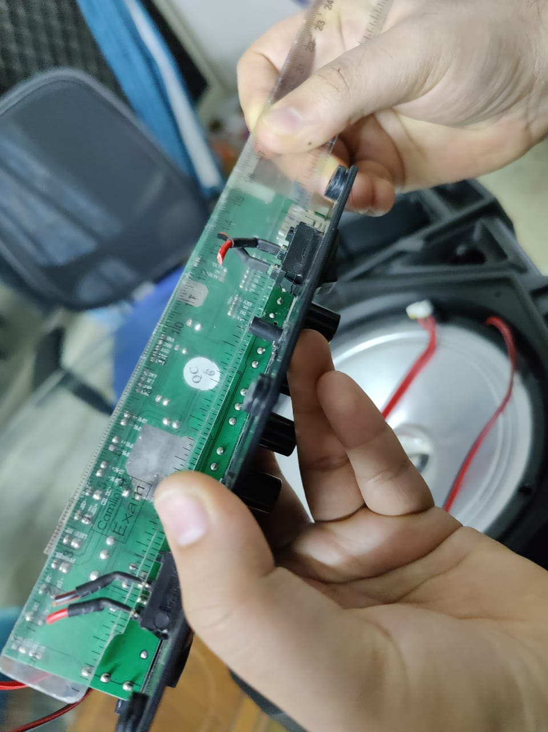
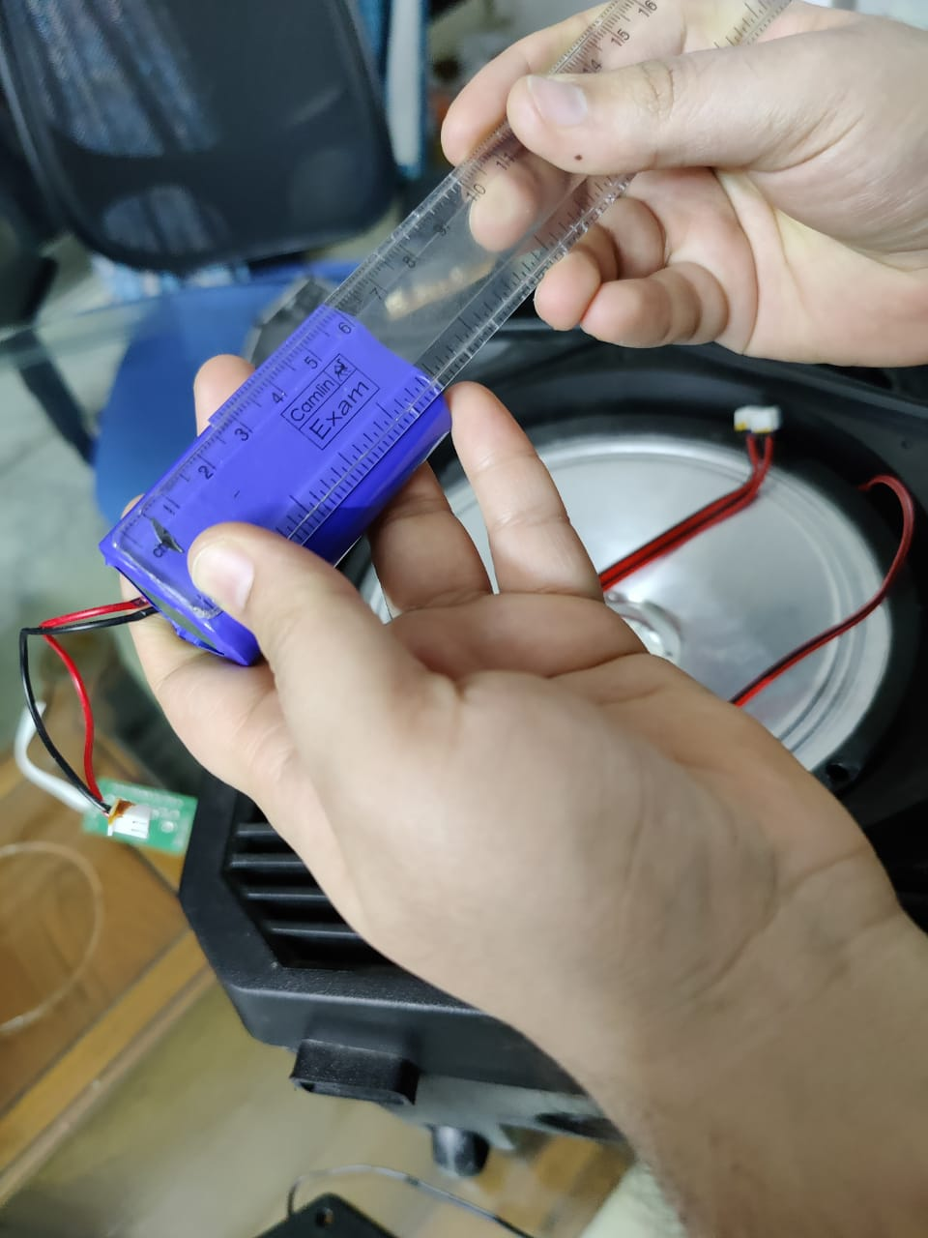
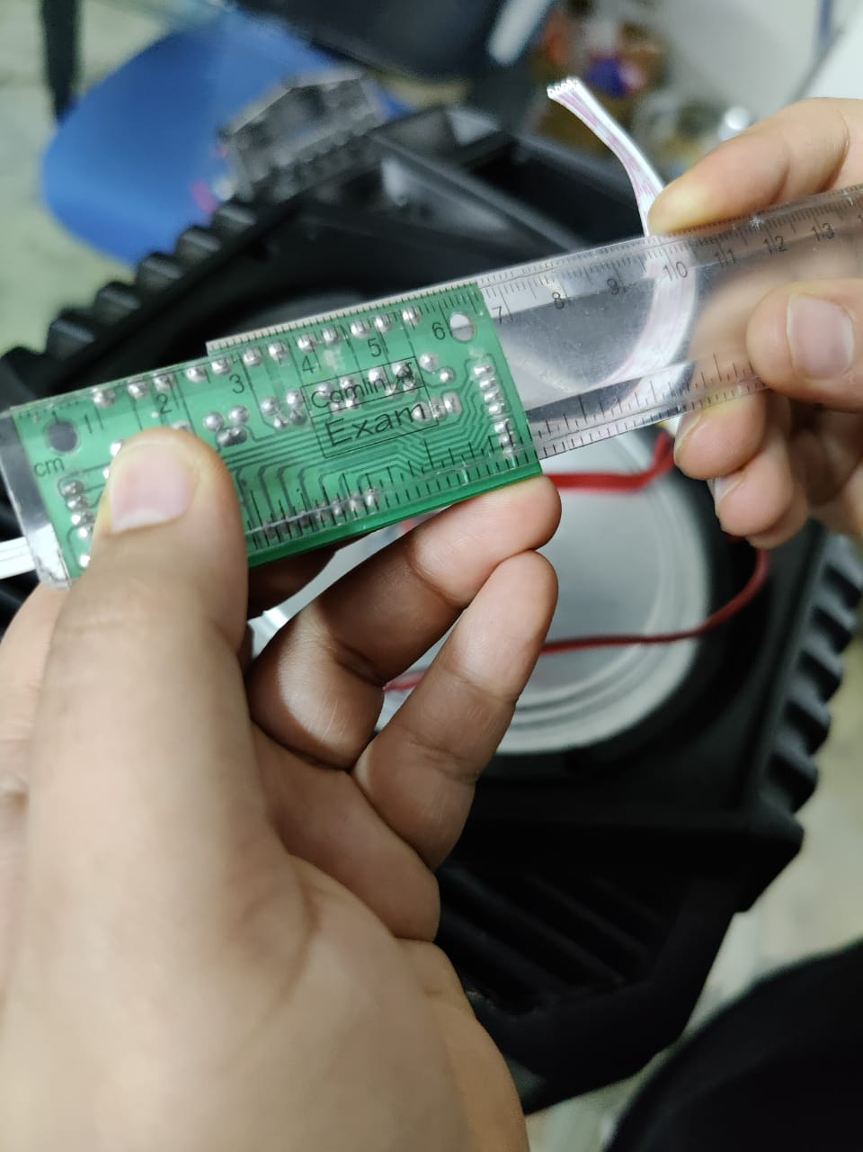
Taking measurements

Slide 10
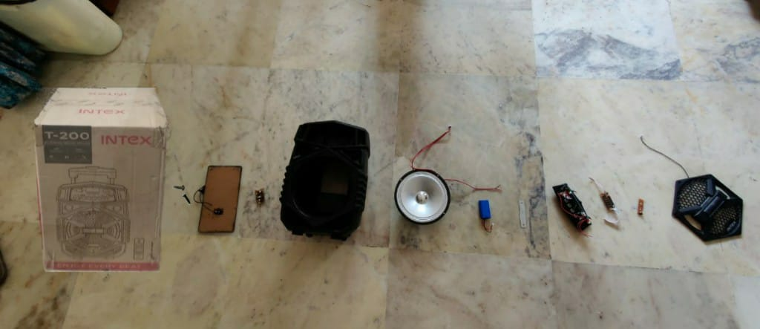
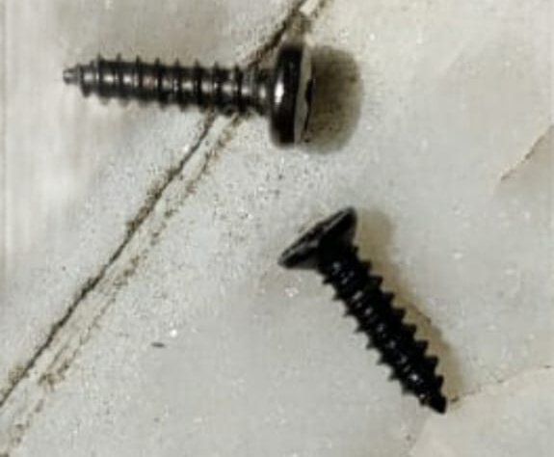
EXPLODED VIEW OF BLUETOOTH TROLLEY SPEAKER
12.Pacakaging box(1)
470x305x285
9.Power circuit(1)
55x30x20
7.Speaker assembly(1)
205diax80
5.Metal strip(1)
100x20x1
3.SCB(1)
66x20x12
1.Front cover case(1)
250x220x20
11.Philips head screws(38)
4.2diax9.5
Axis of Insertion
2.LED circuit
55x15x1
10.Back case cover(1)
26x134x5
8.Main body assembly(1)
430x293x190
6.Li-ion battery(1)
65x18x15
4.PCB(1)
164x34x20

Slide 11
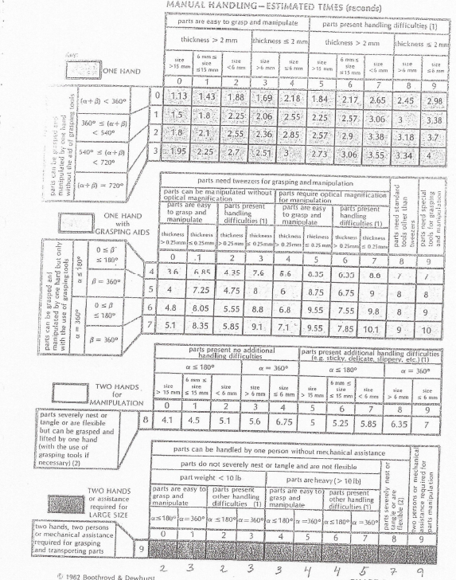
Manual Handling time – Estimation chart

Slide 12
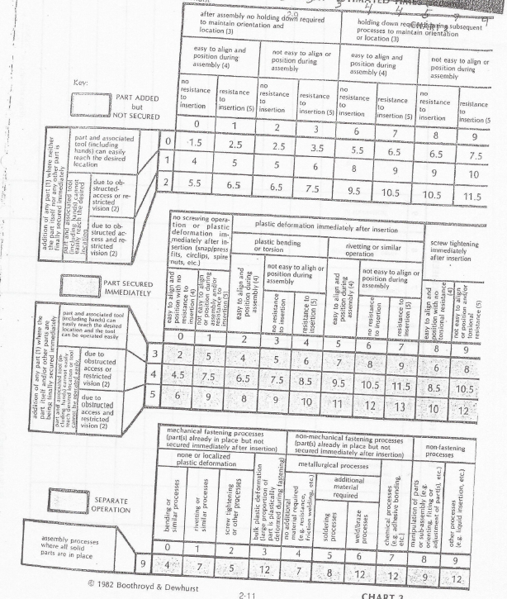
Manual Insertion time – Estimation chart

Slide 13
DISASSEMBLY VIDEO

Slide 14
VIDEO LINK
CLICK HERE: PIE DISASSEMBLY

Slide 15
LINK TO BOM FILE
CLICK HERE: BOM FILE

Slide 16
RESULT
After Calculations, our assembly time was 646.14 seconds, 10.76 minutes, which is approximately close to 11 minutes.

Slide 17
THE END
THANK YOU!!

